Slide 1
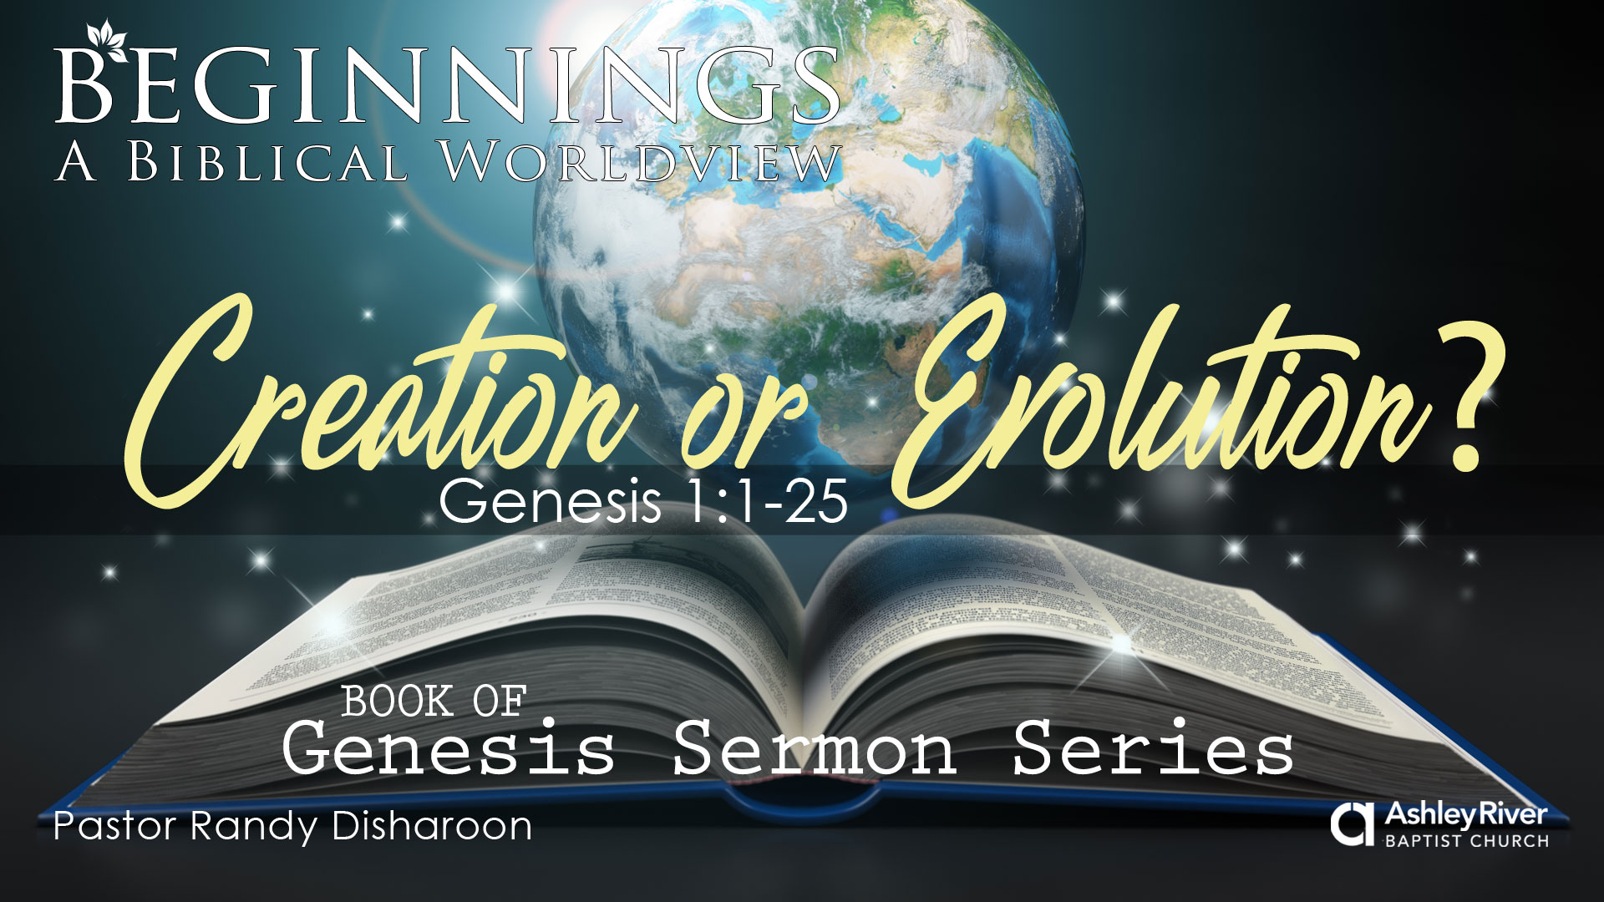

Slide 2
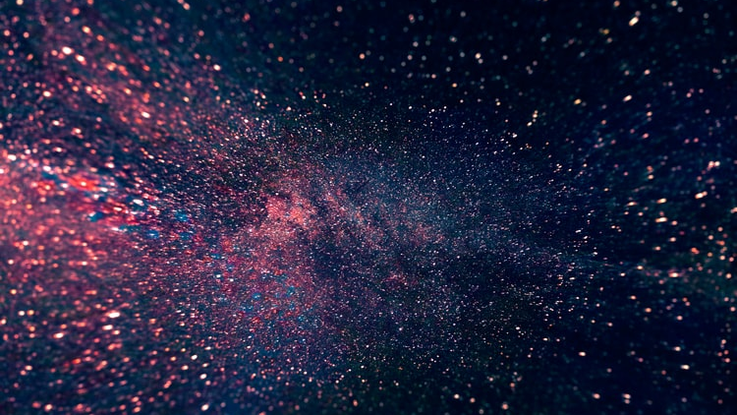
Have a Question?
Simply Text or Email it to:
843-608-8708
info@ashleyriverchurch.org
Your questions are anonymous!

Slide 3
Why Genesis?
Foundational for our biblical worldview
Answers life’s most fundamental questions
Establishes God’s design for His creation
Addresses evolution, gender, marriage and race
Provides the basis for understanding the NT
  68 direct references to Gen. 1-11

Slide 4
Beginnings: Part 1
2/4 Creation or Evolution? Gen. 1:1-25
2/11 In His Image or In Ours? Gen. 1:26–2:7
2/18 Covenant or Cohabitation? Gen. 2:8–2:25
2/25 God’s Truth or My Truth? Gen. 3
3/3 Brotherly Love or Jealousy? Gen. 4
3/10 God’s Genealogy or Man’s? Gen. 5

Slide 5
Human Author: Moses
Life Phase | Scripture | Years | Age | Activity
Natural Training | Ac. 7:23 | 1526 – 1486 B.C. | 1 – 40 | Egyptian Education
Spiritual Training | Ex. 7:7 | 1486 – 1446 B.C. | 40 – 80 | Shepherding Education
Ministry | Dt. 31:2; 34:7 Ac. 7:36 | 1446 – 1406 B.C. | 80 – 120 | Exodus, Law, Wilderness, Writing

Slide 6
Genesis Structure = “Toledot”
1:1 – 2:3 Introduction to the Generations
2:4 – 4:26 Generations of the heavens/earth
5:1 – 6:8 Generations of Adam
6:9 – 9:29 Generations of Noah
10:1 – 11:9 Generations of the sons of Noah
11:10-26 Generations of Shem
11:27 – 25:11 Generations of Terah

Slide 7
Jesus (John 5:39-47)
You search the Scriptures, for in them you think you have eternal life; and these are they which testify of Me. But you are not willing to come to Me that you may have life…I have come in My Father’s name, and you do not receive Me…Do not think that I shall accuse you to the Father; there is one who accuses you—Moses, in whom you trust. For if you believed Moses, you would believe Me; for he wrote about Me. But if you do not believe his writings, how will you believe My words?”

Slide 8
Jesus (Lk. 24:27, 44-45)
And beginning at Moses and all the Prophets, He expounded to them in all the Scriptures the things concerning Himself.
“These are the words which I spoke to you while I was still with you, that all things must be fulfilled which were written in the Law of Moses and the Prophets and the Psalms concerning Me.” And He opened their understanding, that they might comprehend the Scriptures.

Slide 9
Genesis 1:1
  God (Heb. “Elohim”) exists and is eternal
  The universe had a beginning (Heb. “bereshit”)
  God is the only eyewitness (Job 38; Heb. 11)
  God created something out of nothing (ex nihilo)
  The heavens (Heb. “shamayim”) are plural
  The earth (Heb. “erets”) = the perfect place for life

Slide 10
Genesis 1:2
The land was “formless and empty”
  Heb. “tohu wabohu”
  The land was “wild and waste”
“The Spirit of God”
  The 3rd person of the Trinity; the Holy Spirit
  Heb. “Ruach”
  Hovering = anticipating God’s act of creation

Slide 11
The Repetition in Genesis 1
Then God said…
Let…
It was good…
The evening and the morning…
The first (second to sixth) day…
“Day” in Hebrew = “yom”

Slide 12
The Six Days of Creation
Day 1 (vs. 3-5) – Light – God’s glorious Light
Day 2 (vs. 6-8) – Sky – Water above and below
Day 3 (vs. 9-13) – Land; Vegetation – “…their kinds.”
Day 4 (vs. 14-19) – Lights – “…times, days, and years.”
Day 5 (vs. 20-23) – Sea Animals/Birds – “…their kinds.”
God created everything in maturity (vs. 20-21)
“Be fruitful and multiply” – propagation of the kinds
Day 6 (vs. 24-31) – Land Animals/Man – “…their kinds.”

Slide 13
Gen. 1:3-31 – Symmetric Structure
Day 1 | Light | Day 4 | Sun, Moon and Stars
Day 2 | Water, Sky | Day 5 | Sea Animals, Birds
Day 3 | Land, Vegetation | Day 6 | Land Animals, Humankind
Gen. 1 = Creation of the Cosmos (Universe) = 6 days
Gen. 2 = Creation of Anthropos (Humankind) = the 6th day

Slide 14
How Long Did It Take God to Create?
Gap Theory: Original creation occurred in vs. 1
Revelatory Theory: God showed Moses a 6-Day movie
Solar Non-Consecutive Days Theory: Gaps of time between the days
Day Age Theory: Each day is an age
Literal six 24-hour days

Slide 15
The Maturity of Creation
Sir Isaac Newton, General Scholium to the Principia
“Though these bodies may indeed continue in their orbits by the mere laws of gravity, they could by no means have at first derived the regular position of the orbits themselves from those laws. Thus, this most beautiful system of the sun, planets, and comets, could only proceed from the council and dominion of an intelligent and powerful Being.”

Slide 16
Moses’ Intention in Writing
Professor James Barr, OT Hebrew Scholar (Oxford University)
“So far as I know, there is no professor of Hebrew or Old Testament at any world-class university who does not believe that the writer of Genesis 1–11 intended to convey to his readers the idea that Creation took place in a series of six days which were the same as the days of 24 hours we now experience.”

Slide 17
Genesis 1 Recap
Genesis = Beginnings; Moses is the author
God exists and is eternal
The universe had a beginning
God created in 6 days (forming and filling)
“Yom” with a number is always 24 hours; adding evening/morning only cements the fact.
God created everything in maturity
All 3 Persons of the Trinity were involved!

Slide 18
Robert Jastrow, Astronomer
“For the scientist who has lived by his faith in the power of reason, the story ends like a bad dream. He has scaled the mountains of ignorance; he is about to conquer the highest peak; as he pulls himself over the final rock, he is greeted by a band of theologians who have been sitting there for centuries.”

